Slide 1
Cells and Organelles
Year 11 Human Biology
ATAR
PowerPoint #2

Slide 2
SCSA Syllabus Reference
Cell organelles maintain life processes and require the input of materials and the removal of wastes to support efficient functioning of the cell

Slide 3
Lesson Intention
To identify the structure and function of various organelles
To label and recognise different organelles and their functions within a cell

Slide 4
Success Criteria
identify various organelles
state the function of the stated organelles
describe the structure of the stated organelles
label the organelles in an animal cell

Slide 5
Vocabulary
Cytoplasm: the contents of a cell, excluding the nucleus
Centrioles: each of a pair of minute cylindrical organelles near the nucleus in animal cells, involved in the development of spindle fibres in cell division.
Smooth endoplasmic reticulum: a form of endoplasmic reticulum that is involved in the synthesis of lipids, not covered in ribosomes
Rough endoplasmic reticulum: a form of endoplasmic reticulum that is covered with ribosomes involved in the synthesis of proteins.

Slide 6
Vocabulary
Ribosomes: site of protein synthesis; located on the surface of rough endoplasmic reticulum
Cytoskeleton: an internal scaffolding of protein fibres within the cytoplasm of a cell.
Inclusions: chemical substances inside a cell in the form of granules or droplets.
Lysosomes: a small sphere formed from a Golgi body; contains digestive enzymes.
Nucleus: a large organelle in a cell containing DNA

Slide 7
Vocabulary
Nucleolus: a structure within a nucleus; involved in protein synthesis.
Mitochondria: a structure in the cytoplasm of a cell in which the aerobic stage of respiration occurs.
Golgi body: a structure in the cytoplasm of a cell consisting of a stack of flattened channels; it packages materials for secretion from the cell.
Cell membrane: a membrane that forms the external boundary of a cell
Vesicle: a small membrane-bound cavity in the cytoplasm of a cell, smaller than a vacuole.

Slide 8
Cells
The structure of cells allows them to meet the requirements of life
A cell is the smallest structure that can perform life’s functions.

Slide 9
Cytoplasm
Function: thick fluid within the cell membrane that suspends all the structures within it.
Structure: Liquid made up of cytosol (75-90% water and dissolved substances e.g. salts and carbohydrates).

Slide 10
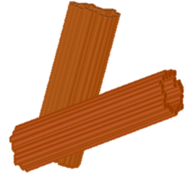
Centrioles
Function: involved in the reproduction of the cell.
Structure: a pair of cylindrical structures located near the nucleus.

Slide 11
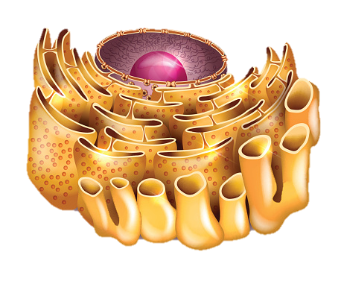
Smooth Endoplasmic Reticulum
Function: provide a surface for chemical reactions, while the channels are for storing or transporting molecules.
Structure: no ribosomes attached to the outside.

Slide 12
Rough Endoplasmic Reticulum
Function: provide a surface for chemical reactions, while the channels are for storing or transporting molecules.
Structure: ribosomes are attached to the outside of some membranes.

Slide 13
Ribosomes
Function: Amino acids are joined together at the ribosomes to make proteins.
Structure: very small and spherical. They may be free in the cytoplasm but most are attached to the membranes.

Slide 14
Cytoskeleton
Function: give the cell its shape and assist in the movement of materials, organelles or the whole cell.
Structure: consists of microfilaments and microtubules.

Slide 15
Inclusions
Substances that are not part of the cell structure but are found in the cytoplasm.
Example: haemoglobin in red blood cells; pigments in cells of the skin.

Slide 16
Lysosomes
Function: break down materials that are taken into the cell or break down worn-out organelles.
Structure: small spheres that contain enzymes.

Slide 17
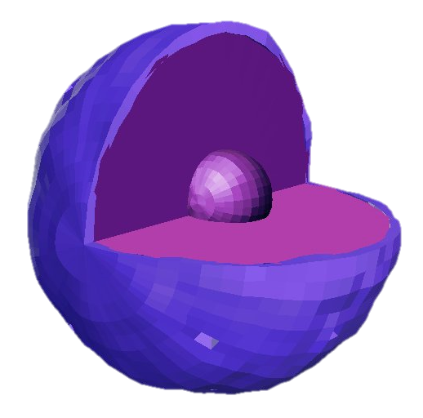
Nucleus
Function: contains DNA (genetic material that determines the type of proteins a cell can make) and plays a part in manufacturing proteins.
Structure: largest organelle in the cell and is usually oval or spherical in shape.

Slide 18
Nucleolus
Function: plays a part in manufacturing proteins.
Structure: small spherical shape organelle inside the nucleus.

Slide 19
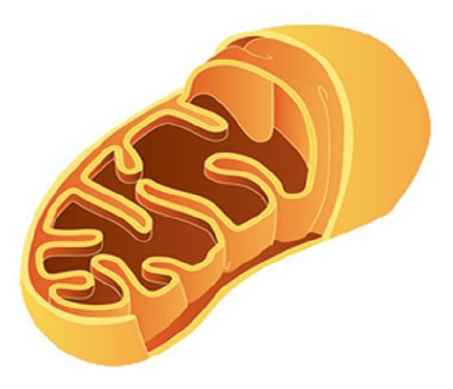
Mitochondria
Function: release energy for the cell through the process of respiration.
Structure: spherical or elongated structure with a double membrane.

Slide 20
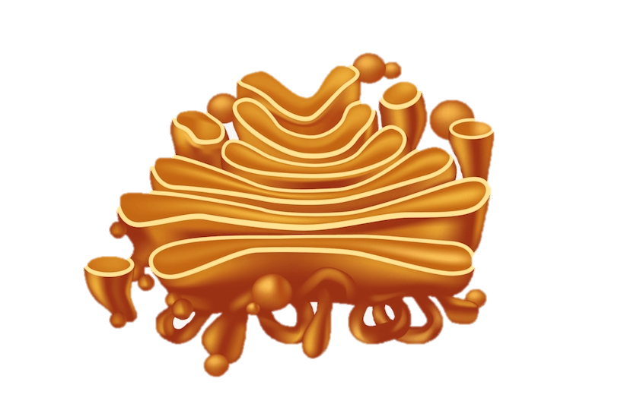
Golgi Body
Function: modify proteins and package them in vesicles for secretion from the cell.
Structure: flattened, membranous bags stacked on top of each other.

Slide 21
Cell Membrane
Function: separates the inside of the cell from outside and controls which substances get into or out of the cell.
Structure: the outer boundary of the cell, made up of a double membrane of lipid molecules and associated proteins.

Slide 22
Vesicle
Function: transports materials into, out of or within the cell.
Structure: a membrane-bound sac

Slide 23
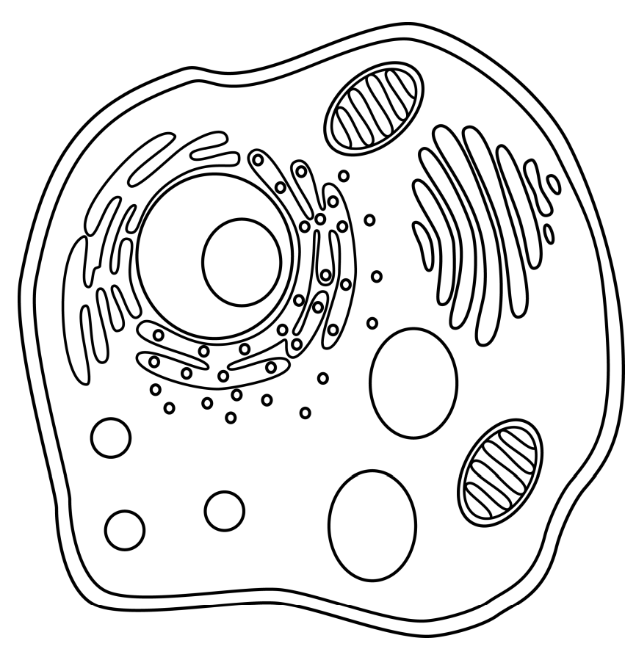
Recall Knowledge
Draw the animal cell and label the:
Cell membrane
Nucleus
Mitochondria
Golgi Body
Smooth Endoplasmic Reticulum
Rough Endoplasmic Reticulum
Lysosomes
Nucleolus
Ribosomes
Vesicles
Cytoplasm

Slide 24
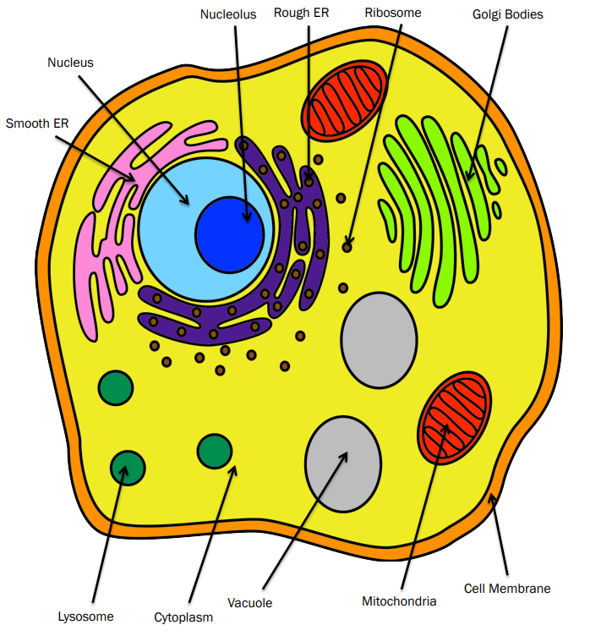
Vacuoles/Vesicles

Slide 25
Apply Knowledge
State the difference between rough and smooth endoplasmic reticulum
Explain how lysosomes and vesicles may work together.

Slide 26
Homework
The nuclear membrane has large gaps in it. Explain the importance of these gaps.

Slide 27
Reading
Pages 26-31 : Cell Structure

